Slide 1
PREDICTING CUSTOMER BEHAVIOUR
BRITISH AIRWAYS
PRESENTATION BY EMMANUEL DE-GRAFT

Slide 2
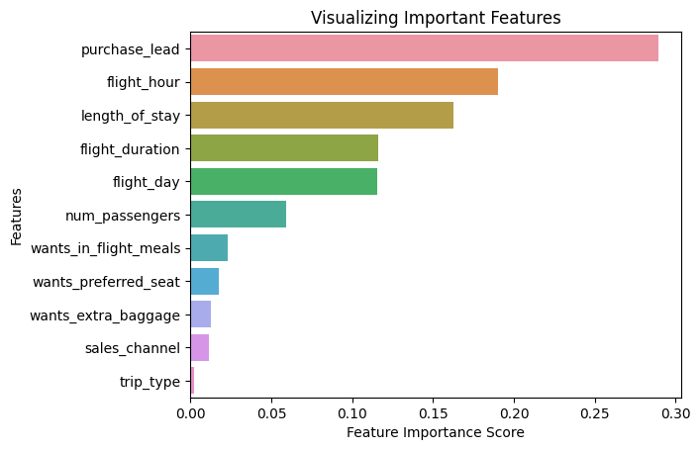
Predicting Customer Behaviour
With an accuracy of 0.8481, the features purchase lead, which is the number of days between purchase and departure is the most important variable followed by flight hour. Meanwhile, the trip type is the least important variable

